Slide 1
The Great India Hackathon
Team Name – The Vision
Project Name - Shikayatt
Team members:-
1.Vansh Bhargava
2.Varinderpal Singh
3. Vidushi Jaiswal
4. Vivek Raj

Slide 2
About Project
This website provides you with the assurance of your complaints to be sucessfully reached to the desired target.
This website would surely help to make your complaints to be fulfilled and draw the faculty's attention toward that issue you are struggling with.

Slide 3
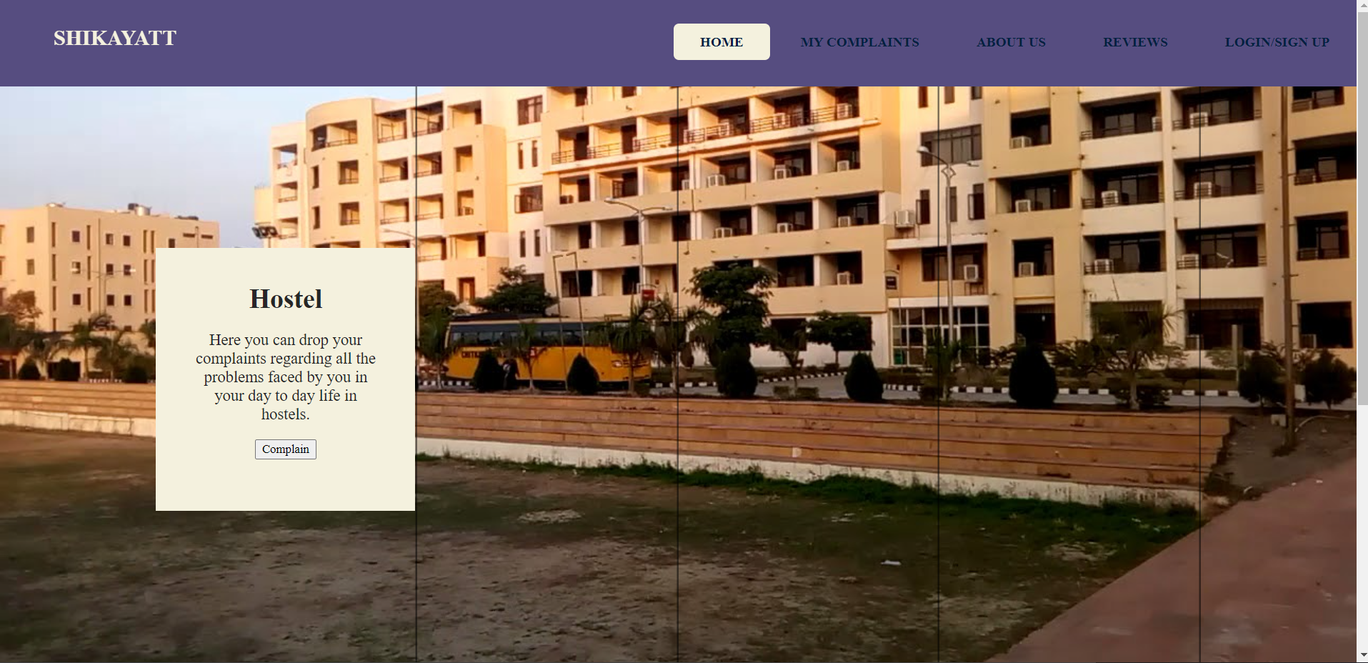
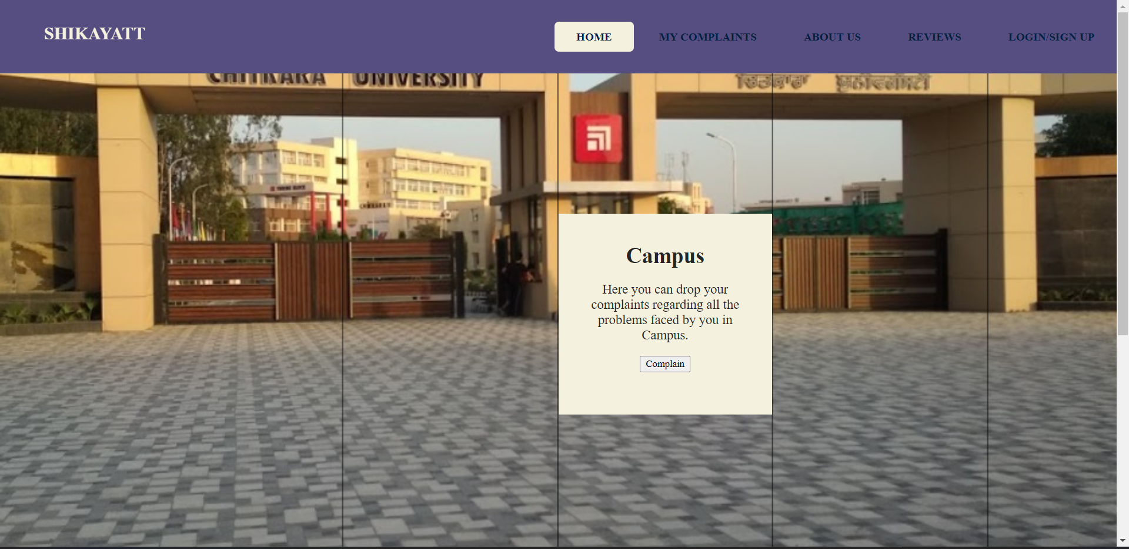
Screenshots of project
Camus complaints
Hostel complaints

Slide 4
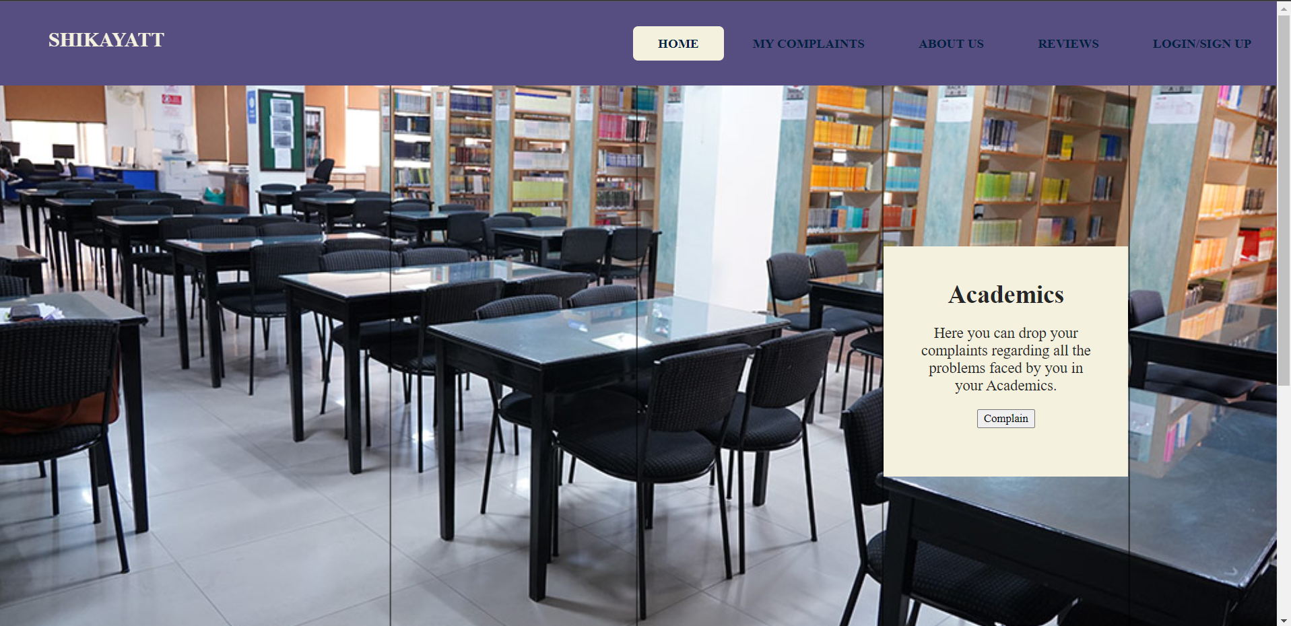
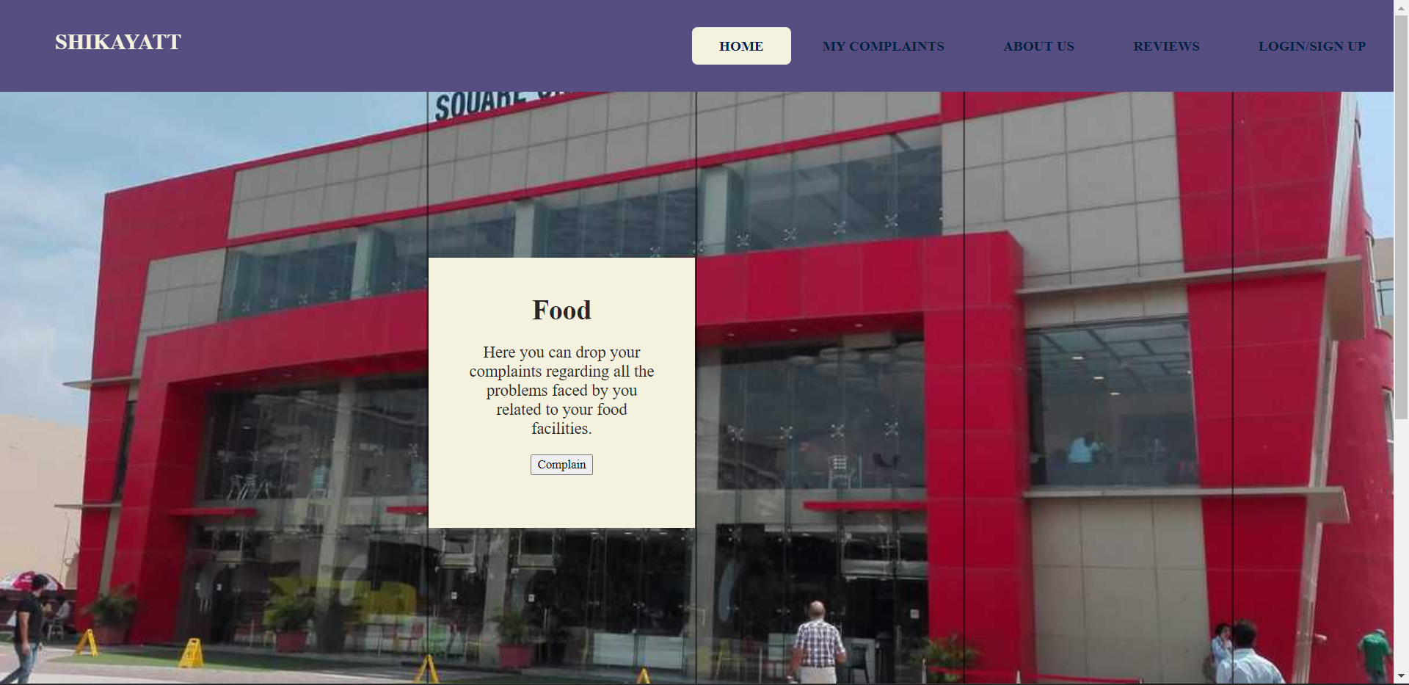
Screenshots of project
Food complaints
Academic complaints

Slide 5
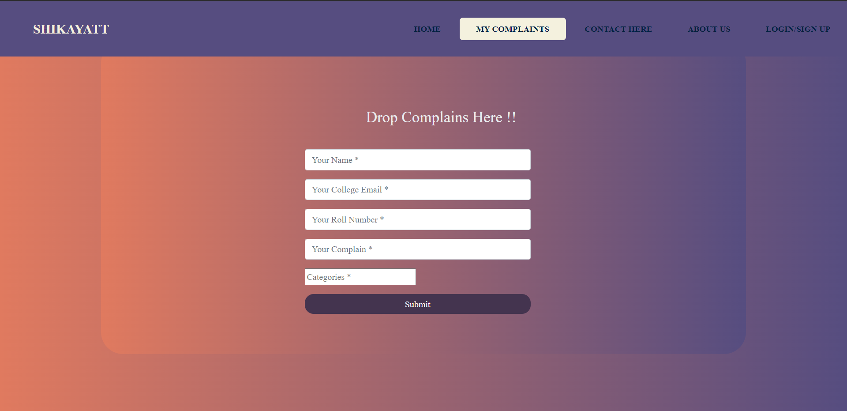
Screenshots of project
Complain box
This is the complain box where we can complain about respective issues
The data we enter here and further when we submit , it will be send via email to a respective department.

Slide 6
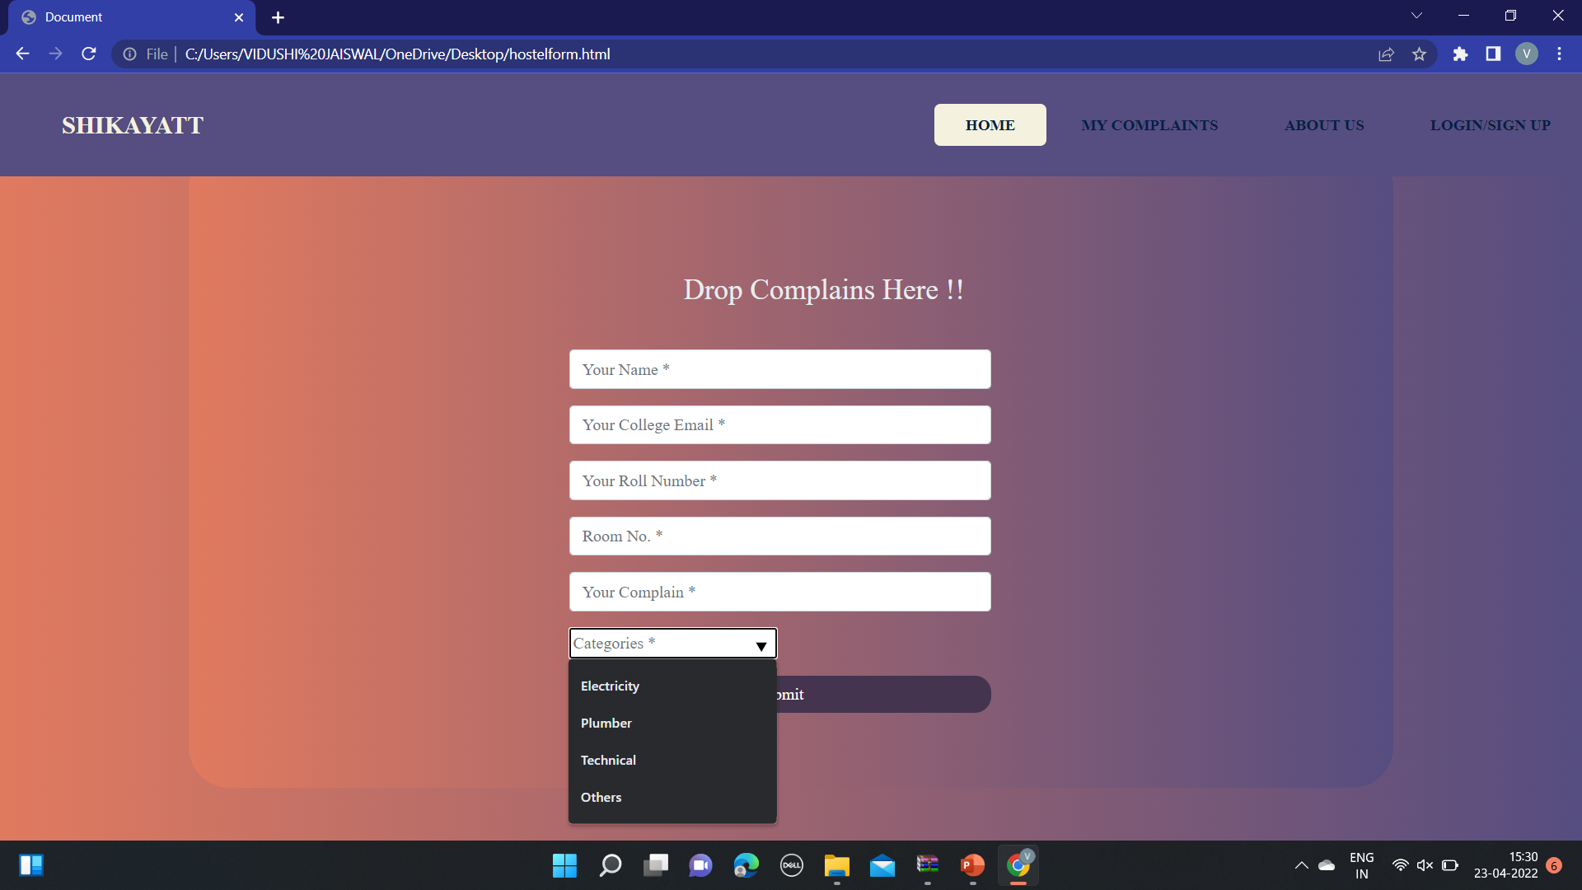
Sub categories of complaint box
In the image shown we have added the sub categories for hostel, some of them are:-
Electricity
Plumber
Technical etc.

Slide 7
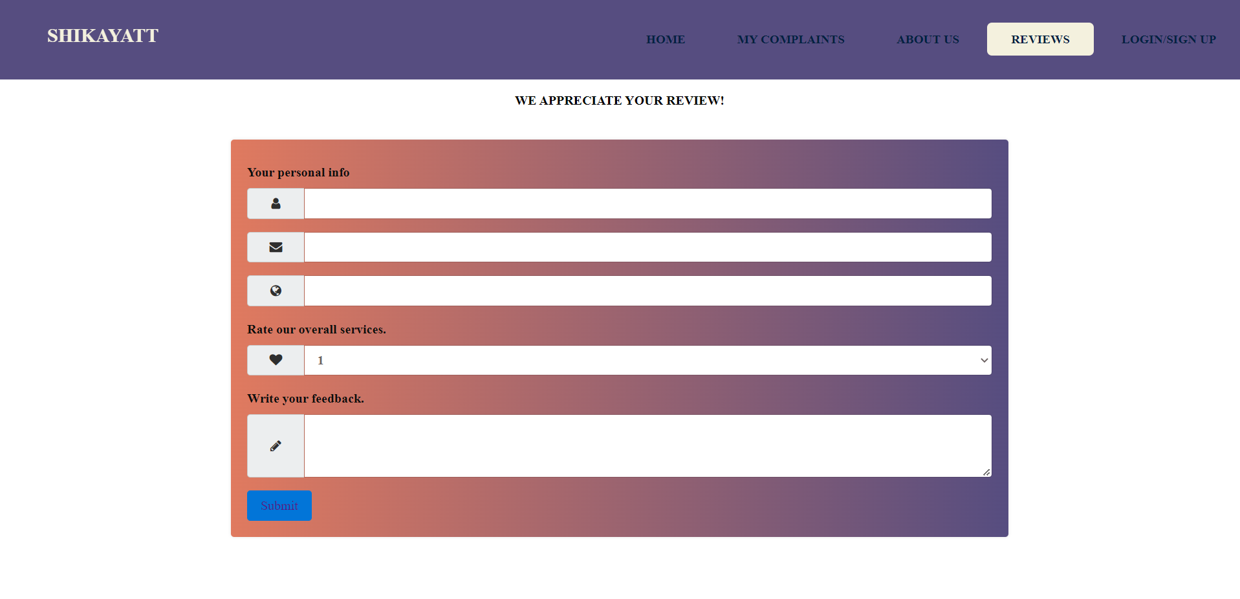
Screenshots of project
Review Box
Secondly, we have made a review box
Where we can write our reviews regarding different topics like canteens, mess food etc.

Slide 8
Upcoming additions to our projects.
Lost & Found:-
we will make a lost and find section where students can upload details about their lost items
And similarly if anyone found the lost items they can give the details of that product, which therefore will be very helpful to the students

Slide 9
Upcoming additions to our projects.
Club related queries:-
we decided to make a web page related to club queries where students can upload their queries related to joining, upcoming events etc.
Also students can get information about the heiring posts of the clubs also

Slide 10
Thank you!!

